Slide 1
Forecasting & Risk Analysis Final Project
Group 6: Zach Biery, Eric Wimmel, Jacob Lesko

Slide 2
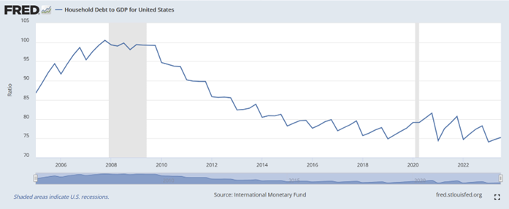
DATA SOURCE
Household Debt to GDP ratio from 2005-2023
For our project, we are analyzing data from the St. Louis FRED website
https://fred.stlouisfed.org/series/HDTGPDUSQ163N

Slide 3
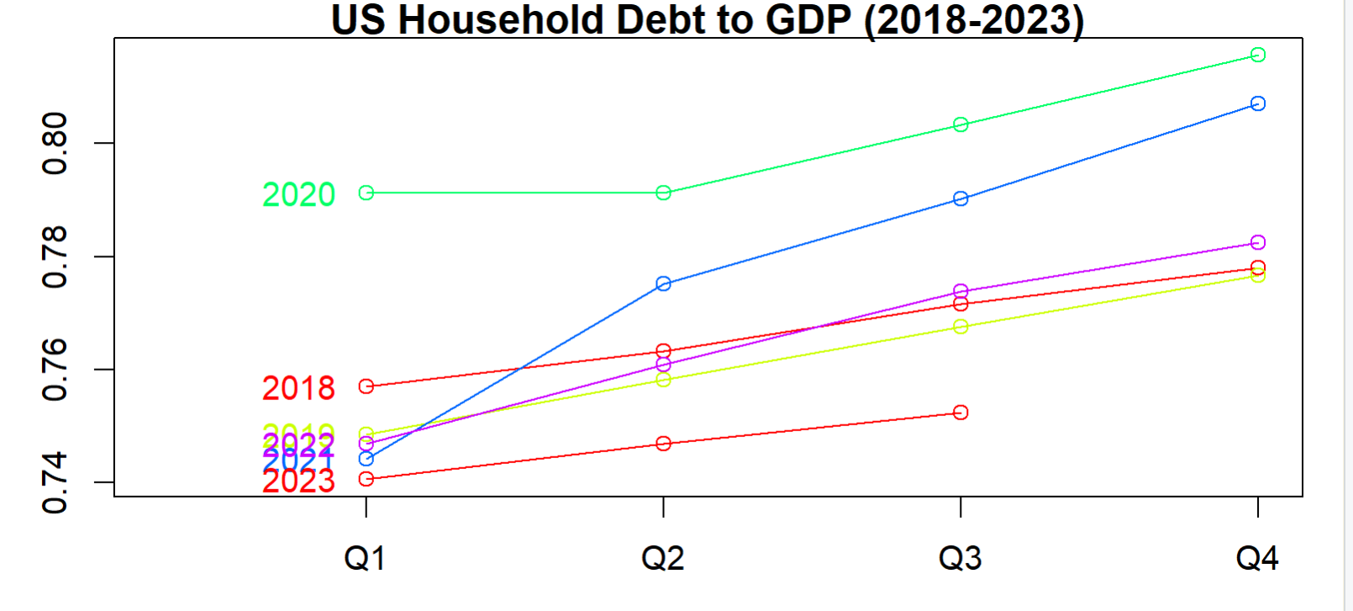
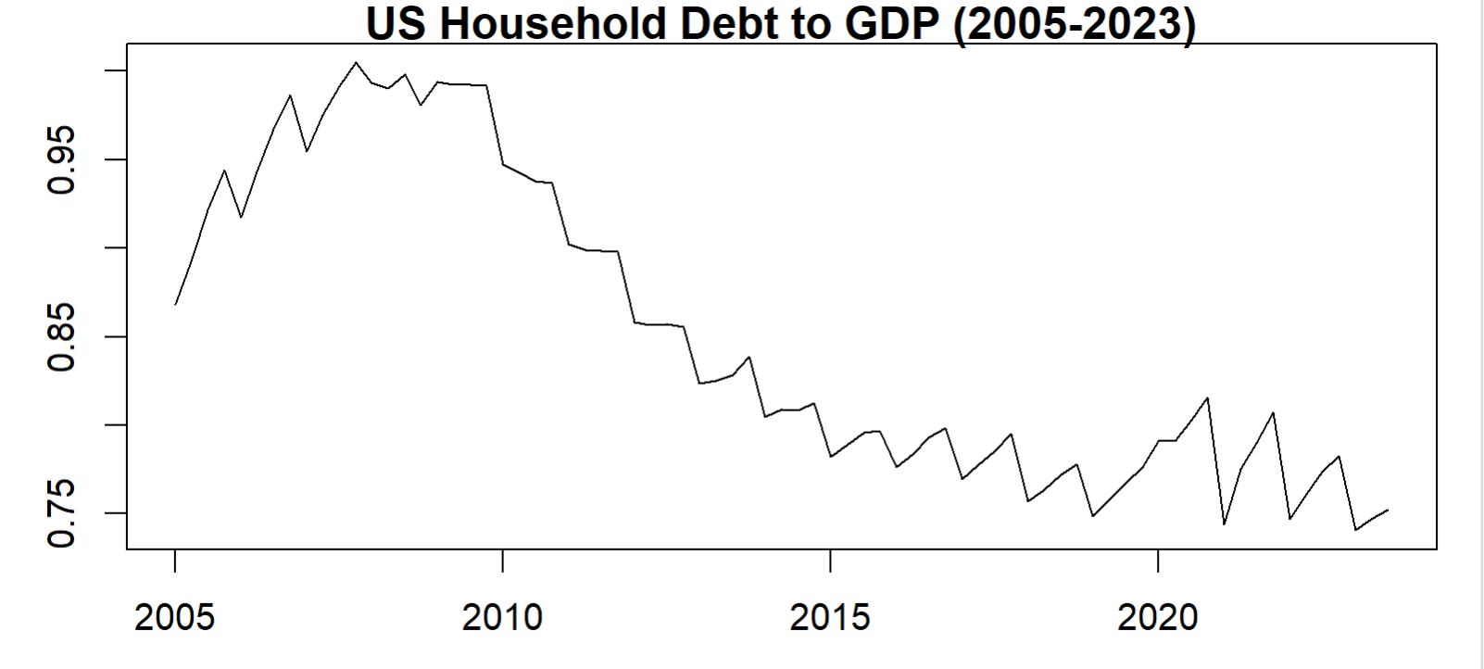
DETAILS & VISUALIZATION
Household debt-to-GDP ratio measures the overall level of household indebtedness as a share of a country’s GDP
Higher ratios indicate recessionary periods & financial instability
2005-2010: Great Recession/Housing Bubble
Massive spike in household debt & reduced GDP
2010-2019: Expansionary Economic Phase
Consumer debt decreases
2019-2022: Covid Pandemic
Small spike in household debt & reduced output
2023-Present: Pandemic Recovery

Slide 4
MODEL DEVELOPMENT
To predict the level of household indebtedness for the coming years we have created the following models:
Moving Average (MA)
Simple Exponential Smoothing (SES)
De-seasonalized Linear Exponential Smoothing (LES)
Holt-Winters
Autoregressive integrated moving average (ARIMA)
Models were primarily evaluated using Information Criterion, both AIC & BIC
Penalizes model complexity, which is beneficial to ensure data is not overfit
Less computationally intensive – faster to implement
Allows for all the data to be used
Less receptive to skewing by outliers in data
Better for evaluating smaller sample sizes – data contained just 75 observations
MSE & MAE were used to further evaluate the best performing models according to AIC
Estimation (~75%) : 2005 Q1 – 2018 Q4
Holdout (~25%) : 2019 Q1 – 2023 Q3

Slide 5
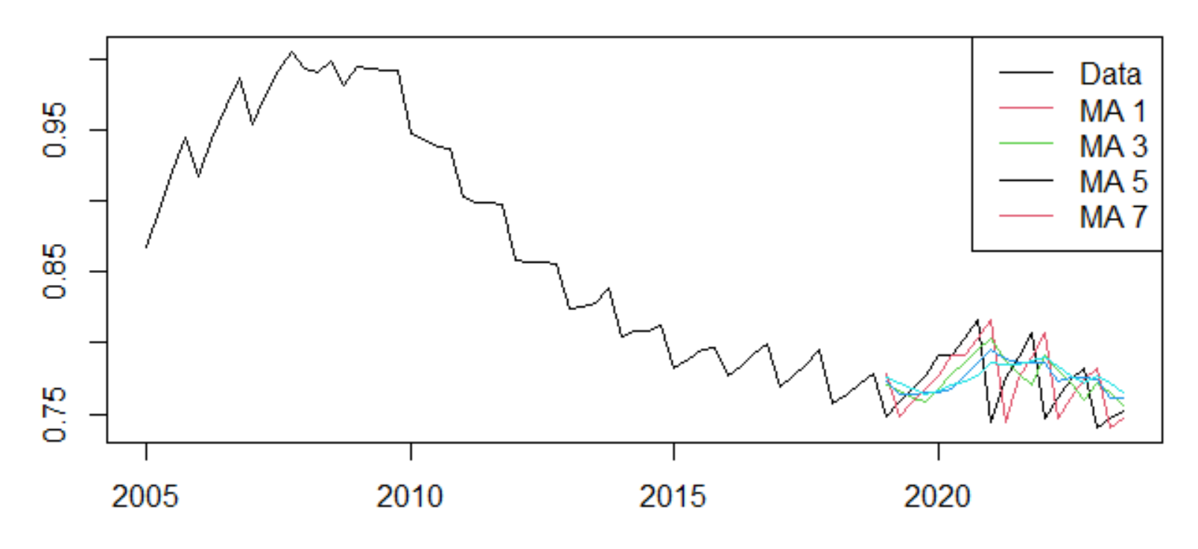

1. MOVING AVERAGE
Applied Moving Average (MA) models with orders 1, 3, 5, and 7
Utilized rolling origin estimation method to forecast
Model 1 with order 1 performed best according to AIC
All models lagged behind data
Did not produce good fits
Nature of moving averages

Slide 6
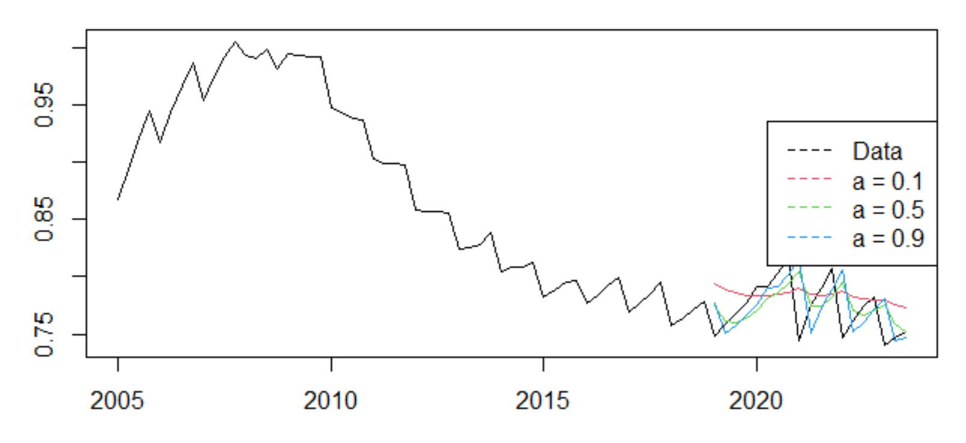
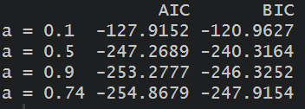
2. SIMPLE EXPONENTIAL SMOOTHING (SES)
Created 4 models with a different smoothing parameter (alpha): 0.1, 0.5, 0.9 & 0.74
0.74 was chosen by R
Model 4 (a = 0.74) performed best according to AIC
Model 2 (a = 0.5) performed best according to holdout RMSE & MAE
All models produced forecasts that led (opposed to lagged) the data

Slide 7
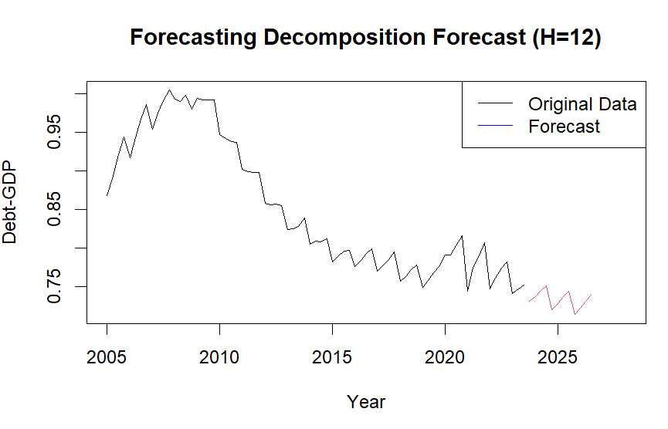

3. DESEASONAL LINEAR EXPONENTIAL SMOOTING (LES)
Data was deseasonalized using two approaches
Forecasting Decomposition
Decomposed into trend, seasonality, & residuals
Removed seasonal component
Fit model
Pure Decomposition
Create a centered moving average
Detrend
Produce seasonal factors
Deseasonalize
Fit model
Model 1 (forecasting decomposition) performed best

Slide 8
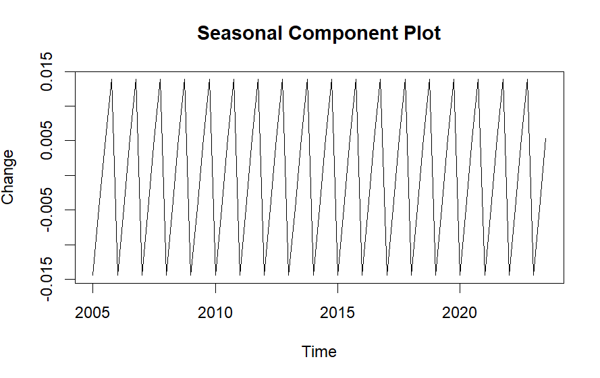
3. DESEASONAL LES (CONTINUED)
These models outperformed expectations
Outperformed Holt-Winters models
Deseasonalization assumes a constant pattern/seasonal trend
In contrast, Holt-Winters methods dynamically adjust seasonal components
Seasonal component does not need to be updated or adjusted for this data due to its constant seasonal pattern

Slide 9
4. HOLT-WINTERS
Created 3 models using Holt-Winters methods
Additive model
Parameters: alpha = 0.15, beta = 0.136, gamma = 0.0001
Additive model (No Seasonal)
Parameters: alpha = 0.306, beta = 0.145
This model was tested because gamma was negligible in the additive model (see “gamma” above)
Damped Additive Model
Parameters: alpha = 0.405, beta = 0.131, gamma = 0.004, phi = 0.804
Multiplicative model
Parameters: alpha = 0.578, beta = 0.126, gamma = 0.1311
Expected - but did not receive - good performance due to Holt-Winters natural ability to capture seasonality
Models did not perform well due to the constant seasonal pattern
Seasonal effects did not need to be updated, resulting in low seasonal smoothing parameters (gamma) across the board

Slide 10
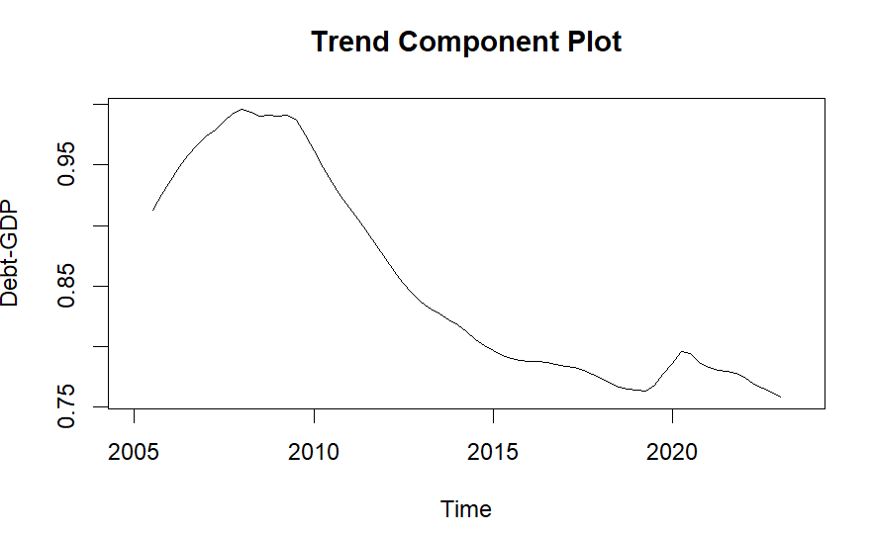

4. HOLT-WINTERS (CONTINUED)
The damped additive model (Model 3) performed the best according to the Information Criteria
This can be explained by simply looking at the trend within the data
The effect of the trend diminishes over time as the trend component bottoms-out, approaching a constant value

Slide 11
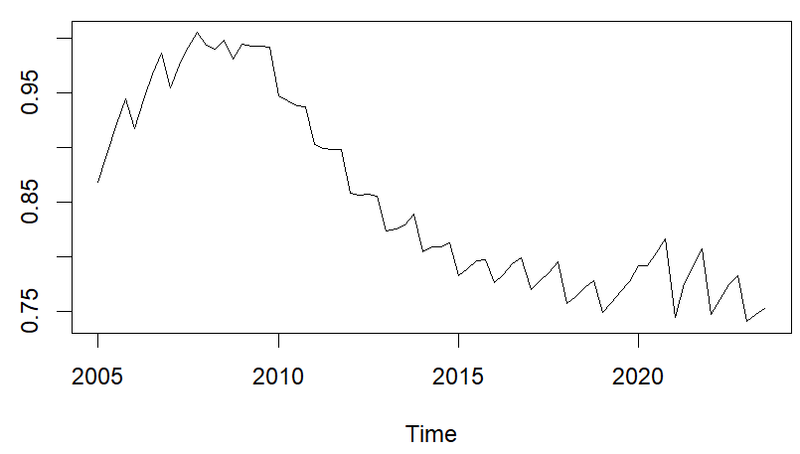
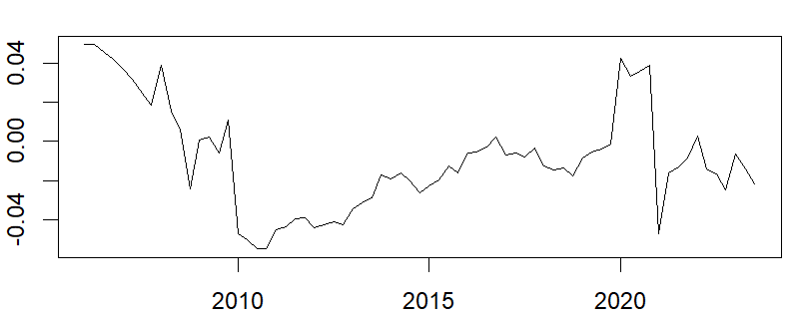
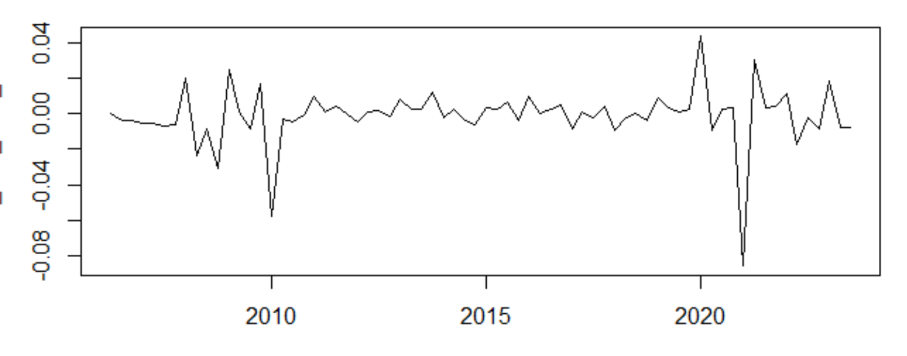
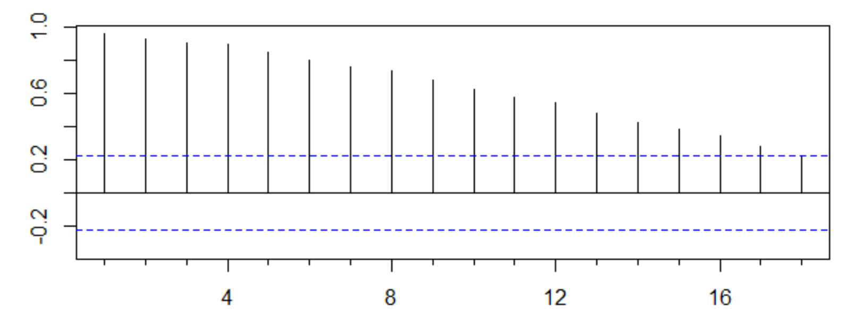
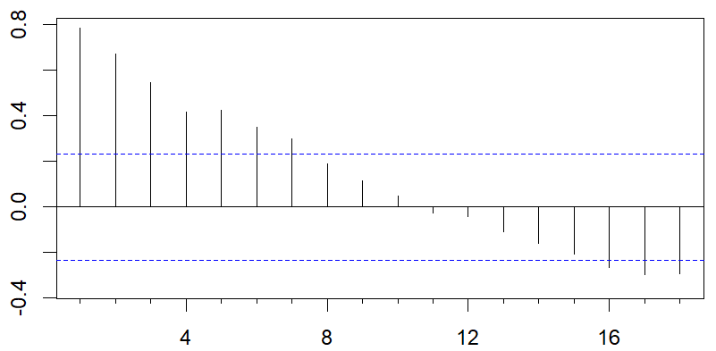
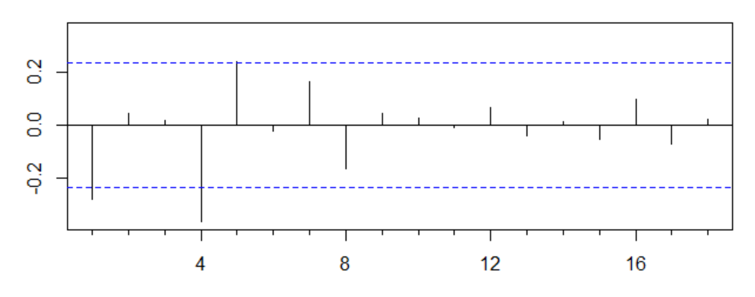
5. AUTOREGRESSIVE INTEGRATED MOVING AVERAGE (ARIMA)
Time Series Plots
Original
1st order differencing
Data was non-stationary
2nd order differencing
ACF Plots

Slide 12
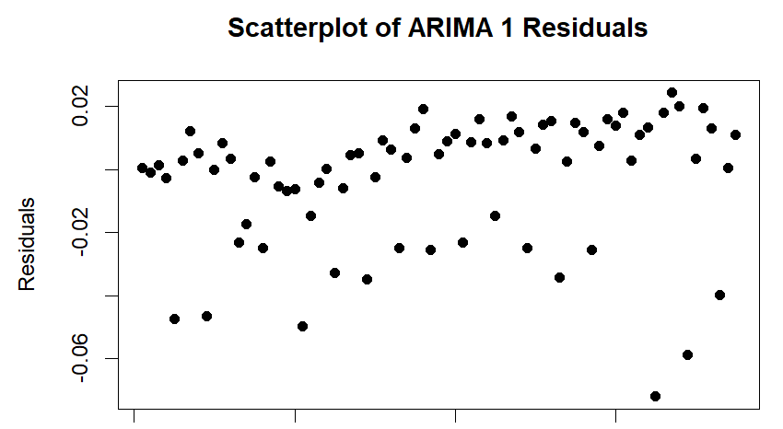
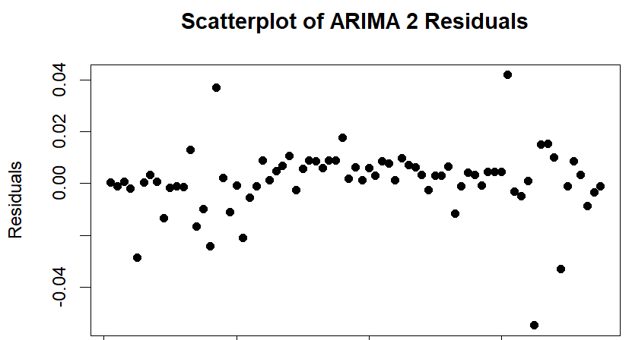
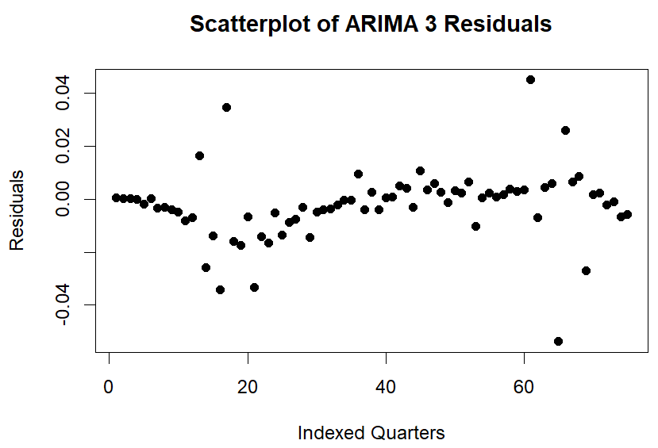

5. ARIMA (CONTINUED)
Before any models were fitted, differencing was used to make the data stationary
Three ARIMA models were fit:
ARIMA (1,2,1)
Order determined by examining ACF & PACF plots, no seasonal
ARIMA (1,2,1)(1,0,1)
Same order as Model 1 but with added seasonal
ARIMA (0,1,0)(0,1,1)
Order and seasonal determined by R using auto ARIMA function
Model 2 performed the best out of these models

Slide 13
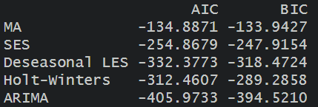
SELECTED MODEL & PARAMETER ESTIMATES
Took the best performing model from all 5 model types and compared the AIC values
ARIMA (1,2,1)(1,0,1) – 2nd ARIMA model – performed the best overall because it had the lowest AIC (-405) and BIC (-394)
The parameters for this model are as follows:
Order: p = 1, d = 2, q = 1; Seasonal: P = 1, D = 0, Q = 1

Slide 14
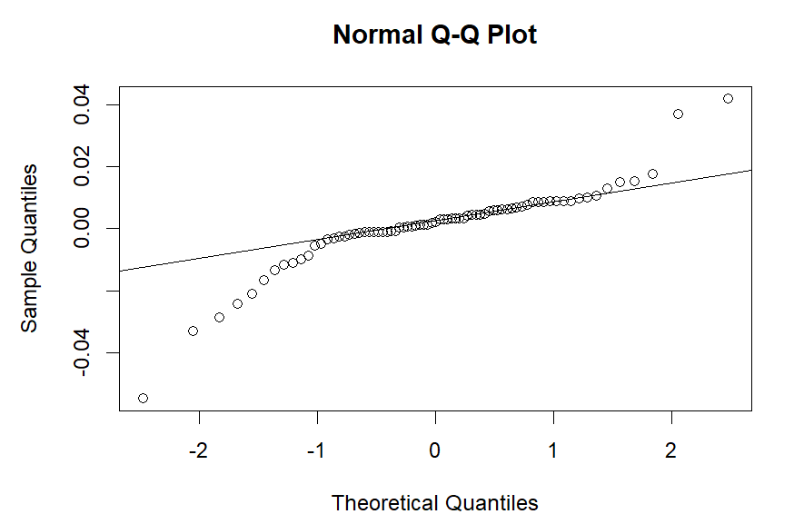
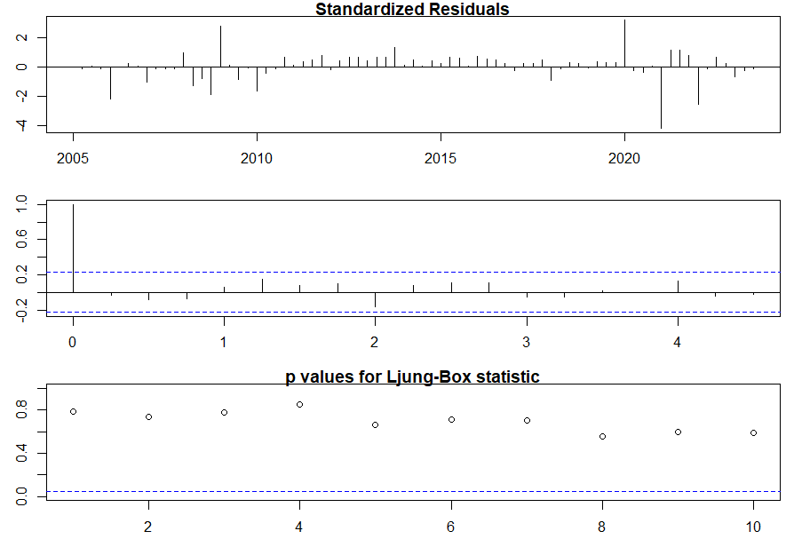
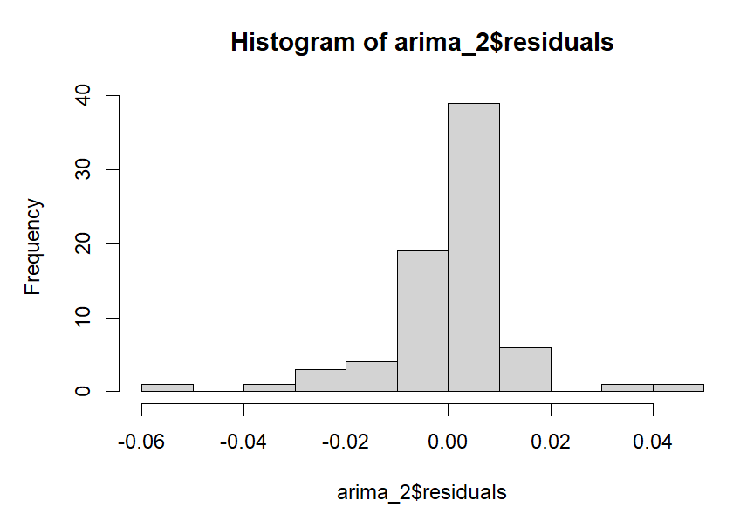
MODEL DIAGNOSTICS

Slide 15
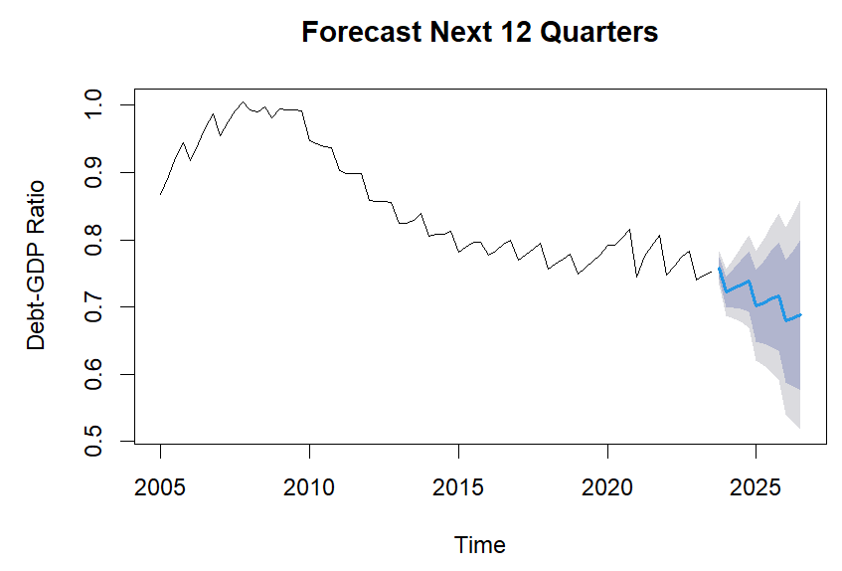
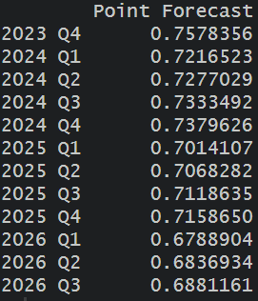
FORECAST, H = 12

Slide 16
INTERPRETATION OF RESULTS
All predictions seem to project a slight decrease in the Debt to GDP ratio in the coming quarters
As the predictions are farther out in time, the confidence intervals become more distant
This is especially true for the 95% confidence interval, which is to be expected
The model's predictions seem to capture the overall trend and seasonality of the dataset

Slide 17
POTENTIAL IMPACT
Informs policymakers of how the Debt to GDP ratio may look in the future, allowing for better economic planning and policy decisions
Using the model consistently will allow for updated forecasts of how recently implemented policies may be impacting the economy, and what to change
Allows investors to make more knowledgeable predictions of how markets will look in the United States and internationally
Better predictions of Debt to GDP ratio and other economic indicators allow investors to make more informed decisions of where and how to invest their money
Helps prevents economic instability by giving economists, investors, and policymakers better insight into the direction of the economy

Slide 18
LIMITATIONS
Dataset was limited to what was publicly available
Because this data is collected quarterly and it only dates back to 2005, it has <80 data points total
Models assume that things will remain similar in the US economy, monetary policy, and international trade/relations
This is not always a good assumption, as seen by recent interest rate hikes
Could have further tuned parameters for each model to increase accuracy
Only evaluated models based on AIC
Could have additionally considered other metrics, which could have changed our analysis of the models and their predictions

Slide 19
THANK YOU!
Questions?

